Slide 1


Quality
Assurance
Process
Programme 4
Leaving a legacy.
Making the future count.

Slide 2
Delegation of function by QCTO
As per delegation of the Quality Council for Trades and Occupations (QCTO) in terms of the NQF Act (Act No.67 of 2008) & Skills Development Act , 1998 (Act no 97 of 1998 as amended).
QCTO delegated Quality Assurance functions to all SETA’s to manage qualifications in the Occupational Framework and Accreditation
SASSETA’s continues to accredit training providers for legacy qualifications (expires June 2023)
All legacy qualifications which are still required by the sector must be replaced by Occupational Qualification.

Slide 3
Functions of the Development Quality Partner (DQP)
Development Quality Partner (DQP) means a body delegated by the QCTO to manage the process of developing specific occupational qualifications, curricula and assessment specifications
Fund and coordinate the Qualifications development process
Appoint the Qualifications development facilitator (QDF) / Subject Matter Facilitator
Prepare the qualifications development process report
Manage the qualifications verification process
Submit the developed Curriculum document, Assessment Specifications document, Qualification document, process report and attendance registers for all meetings

Slide 4
Function of the Assessment Quality Partner (AQP)
Assessment Quality Partner (AQP) means a body delegated by the QCTO to develop assessment instruments and manage the external summative assessment of specific occupational qualifications
Coordinate and manage external assessment processes
Ensure that criteria and guidelines are in place for implementing external integrated summative assessments (EISA)
Ensure that there is a reliable and secure electronic database to record learner registration, assessment centres, external assessment application
Recommend the certification of learners to the QCTO
Report to the QCTO on the performance of functions in the form and manner required by the QCTO; and
Promote continuous professional development of AQP associated practitioners

Slide 5
Expiration Date
All legacy qualifications will be replaced by Occupational Qualification.
SASSETA’s continues to accredit training providers for legacy qualifications (expires June 2023)
Learner enrolment end date 30 June 2024
Last achievement date 30 June 2027
Historical Qualification (Old) | Occupational Qualification (New)
Unit standard based: Core Fundamentals Electives | Modules: Theory / Knowledge Practical Skill Work Experience contain between 5% and 10% of soft skills which may include inter alia personal development, self-learning, workplace preparation etc.

Slide 6
The purpose of an occupational qualification is to qualify a learner to practice an occupation, reflected on the Organising Framework for Occupations (OFO)
A qualification associated with a trade, occupation or profession resulting from work-based learning and consisting of:
Knowledge / theory
Practical
Work experience
External Integrated Summative Assessment
Occupational Certificate

Slide 7
NMHET Determination on Sub-Framework and Qualifications Types
(Government Gazette No 44031 – 24 Dec 2020; No 36803)
Qualifications Framework
No. | Type | NQF Level | Percentage (%) of credits at the level of a qualification | Minimum credits
A. | General Occupational Certificate | 1 | 60 | 120
B. | Elementary Occupational Certificate | 2 | 60 | 120
C. | Intermediate Occupational Certificate | 3 | 60 | 120
D. | National Occupational Certificate | 4 | 60 | 120
E. | Higher Occupational Certificate | 5 | 60 | 120
F. | Advanced Occupational Certificate | 6 | 60 | 120
G. | Occupational Diploma | 6 | 60 | 120
H. | Advanced Occupational Diploma | 7 | 60 | 120
I. | Specialised Occupational Diploma | 8 | 60 | 120

Slide 8
Realignment of Legacy Qualification
Rationale
The realignment process aims to covert historically registered qualification into occupational qualifications
Aimed at ensuring the Occupational Sub-Framework consist of occupational qualification as per the determination by Minister of Higher Education, Science and Technology
Only the historically registered qualifications that have been identified by industry as being relevant will be considered in the realignment process
New occupational qualifications will be developed once identified by industry as being relevant will be considered in the new development process

Slide 9
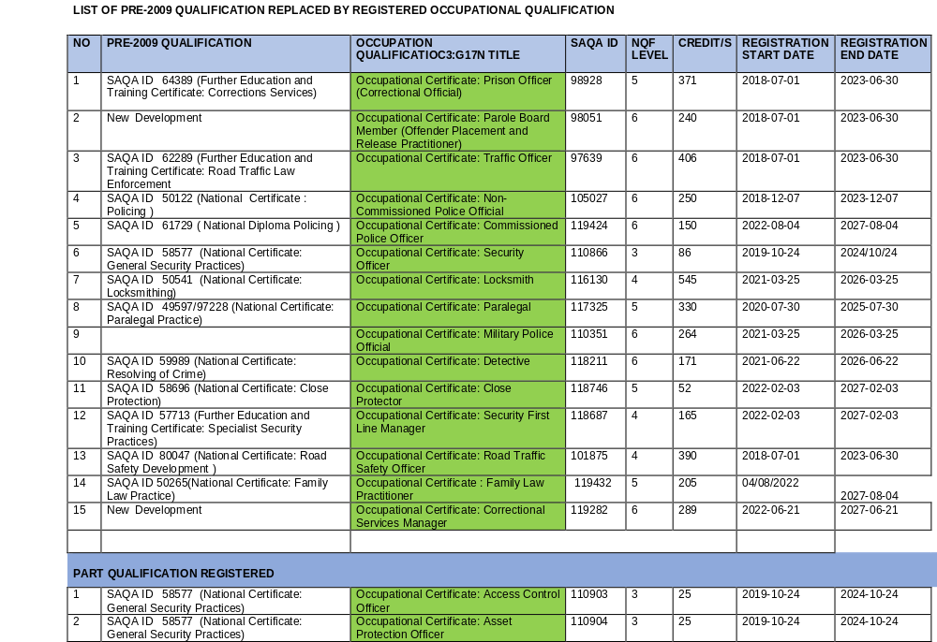

Slide 10
Qualifications with Learner uptake
The following qualifications have not been requested for realignment (learner uptake) | The following qualification have not been requested
50023 | ND: Legal Interpreting
80046 | NC: Tactical Road Traffic Operations
80066 | NC: Strategic Road Traffic Operations
48920 | NC: Attorneys Practice

Slide 11
Process to realign Occupational Qualification
Stakeholders submit requests for re-alignment /new qualification development to SASSETA
QCTO and SASSETA have the right to decline the application for realignment
If the application is declined, reasons will be communicated to the stakeholder
SASSETA submit requests to QCTO
QCTO acknowledges receipt, approves the realignment
SASSETA appoints Qualification Development Facilitator (QDF)
SASSETA coordinates the re-alignment of Qualification in consultation with the Community of Expect Practitioners (CEP’s)
Submits for evaluation to QCTO
The realigned qualification is presented to the QCTO Council for approval
SAQA registered the realigned qualification as an Occupational Qualification

Slide 12

Thank you !
Your partner in skills development

Slide 13
Quality Management System
Implementation of Registered Qualification
Entry requirement / learner access to the qualification ND: Policing 61729 NQF L 6
Learner access to the qualification: Policing at NQF level 5
The qualification consists of core, fundamental and elective component which requires learners to obtain a minimum of 248 credits to be awarded this qualification
Recognition of Prior Learning possible :
  allow for accelerated access to further learning
  Gaining of credits towards a unit standard
  Learners must be able to demonstrate competency in the knowledge and skills
  Supporting documents needed before enrolment

Slide 14
Quality Management System
Assessor & Moderator re-registration process
The following documents are required for submission:
Submit your Comprehensive/detailed CV outlining the work/ occupational experience within the Sector,
Period of experience and indicate your duties and responsibilities in detail linking to the Unit Standards/ Qualification and unpack your role in detail.
Certified ID Copy
Certified Certificates of Competencies
Info.reregistrationassessor@sasseta.org.za

Slide 15
Quality Management System
Provider Accreditation re-registration
NO | TITTLE | REQUIRED DOCUMENTS
1. | Legislative requirements | The following documents should be current. Company registration (Updated Annual Return with CIPC) SARS: Tax clearance /Tax Pin certificate Tax Exemption (NGO or NPO) PSIRA Certificate (If applicable) PAPA Licence (If applicable) NKP Training Certificate (If applicable) Lease agreement / Proof of ownership/ Title deed / Letter from Local Authority Letter from the accounting firm stating that the company is not insolvent / Audited Financial Statement
2. | Accreditation Letter | Copy of current Accreditation Letter: for Head Office and for each branch
3. | Learning Programme Review | Disclosure letter for Programme review or Proof of Learning programme reviewed
4. | ETD Practitioners | Signed MoU/SLA with registered assessors and moderators Copies of the SASSETA Registration Letters for the Facilitators, Assessors and Moderators Comprehensive /Detailed CV Copies of certified certificates of competency for the Facilitators, Assessors and Moderators (certified in 2023)
5. | Occupational Health & Safety | Employment Contract of the OHS Representative Copies of certified certificate of competency relating to OHS (certified in 2023)
6. | Verification Report | Verification Report (not older than 3 Years) Monitoring and Evaluation Report (not older than 3 Years) (For each branch and/or Management area)

Slide 16
Quality Management System
VERIFICATION PROCESS
A process of external verifiers to verify the authenticity of learner results in order to confirm or overturn findings
Purpose
Verification is to evaluate compliance amongst accredited providers in order to endorse / not to endorse learner results
Learner enrolments (QA1, SP01 or WBL Agreement) must be submitted within 21 working days
It is compulsory to have qualified Facilitators (subject matter expert)
Providers must have a signed MoU with Assessors and Moderators registered with SASSETA
Request ETQA to link Assessor and Moderators to your Organisation
Conduct training inline with training plan
100% Assessments and 10% Moderation to be conducted and completed
Confirm that learners to be verified are all enrolled or submitted to SASSETA
Assessment dates must correspond with training period
Request for verification
Submit SP02

Slide 17
Quality Management System
Change of Address / Training venue
Inform SASSETA in time before implementation of training
The following documents are required before site validation:
Formal request
Application update form
Proof of Accreditation letter
Lease agreement to new venue
Lease agreement must signed and stipulate the duration, and purpose
Photos
Contract of Occupational Health and Safety personnel and supporting certificate

Slide 18
Thank you !
Your partner in skills development

